Slide 1


Institut de Technologie du Cambodge
Département de Génie Informatique et
Communication
Khmer Air Writing Recognition (Prototype)
Organization Name : ViLa Lab
Internship Supervisor : Dr. VALY Dona
Student Name : YORN Vanda
2022 - 2023

Slide 2
Agenda
Introduction
Project Overview
Analysis and Design
Implementation
Conclusion
Demo

Slide 3

01
Introduction
Project Overview
Analysis and Design
Implementaion
Conclusion
Demo
Presentation of the Organization
Name of laboratory: ViLa Lab – Computer Vision & Natural Language Processing Lab
Research Location: 6th floor, Building I, ITC
Head of Laboratory: Dr. VALY Dona
1

Slide 4



01
Introduction
Project Overview
Analysis and Design
Implementaion
Conclusion
Demo
What is Khmer Air Writing Recognition?
Computer Vision
Artificial Neural Network
Air Writing Recognition Prototype
2

Slide 5
02
Introduction
Project Overview
Analysis and Design
Implementaion
Conclusion
Demo
Presentation of the Internship Project
Objective
To develop an tool to detect and tracking hand position
Drawing without physical touch
To make the prediction tool which could recognize Khmer character
Be able to clear the screen just like clearing on board in real whiteboard.
3

Slide 6
02
Introduction
Project Overview
Analysis and Design
Implementaion
Conclusion
Demo
Presentation of the Internship Project (Cont.)
Planning
Weeks | Task
1 - 4 | Learning new Technologies
5 - 8 | Build Computer Vision Prototype
9 - 10 | Analyze Function and Requirements to Prototype
11-12 | ANN Model and Prototype Integration
13 - 16 | Testing and Implementation
4

Slide 7
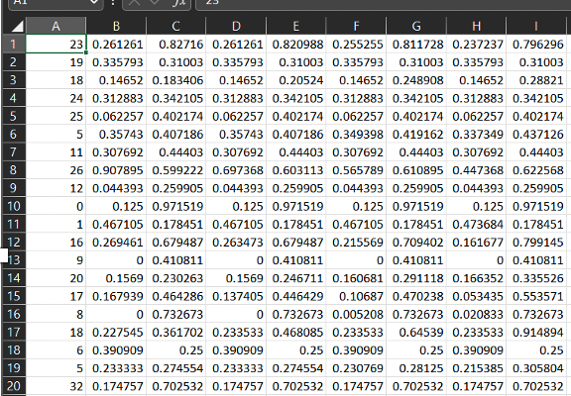

01
Introduction
Project Overview
Analysis and Design
Implementaion
Conclusion
Demo
Data Preprocessing
Dataset File
Label, x₁, y₁, x₂, y₂, x₃, y₃, x₄, y₄, ...x_{n}, y_{n}
Label: { 0, 1, 2, . . . . . . . 32}
(x_{n}, y_{n})
(x₁, y₁)
5

Slide 8
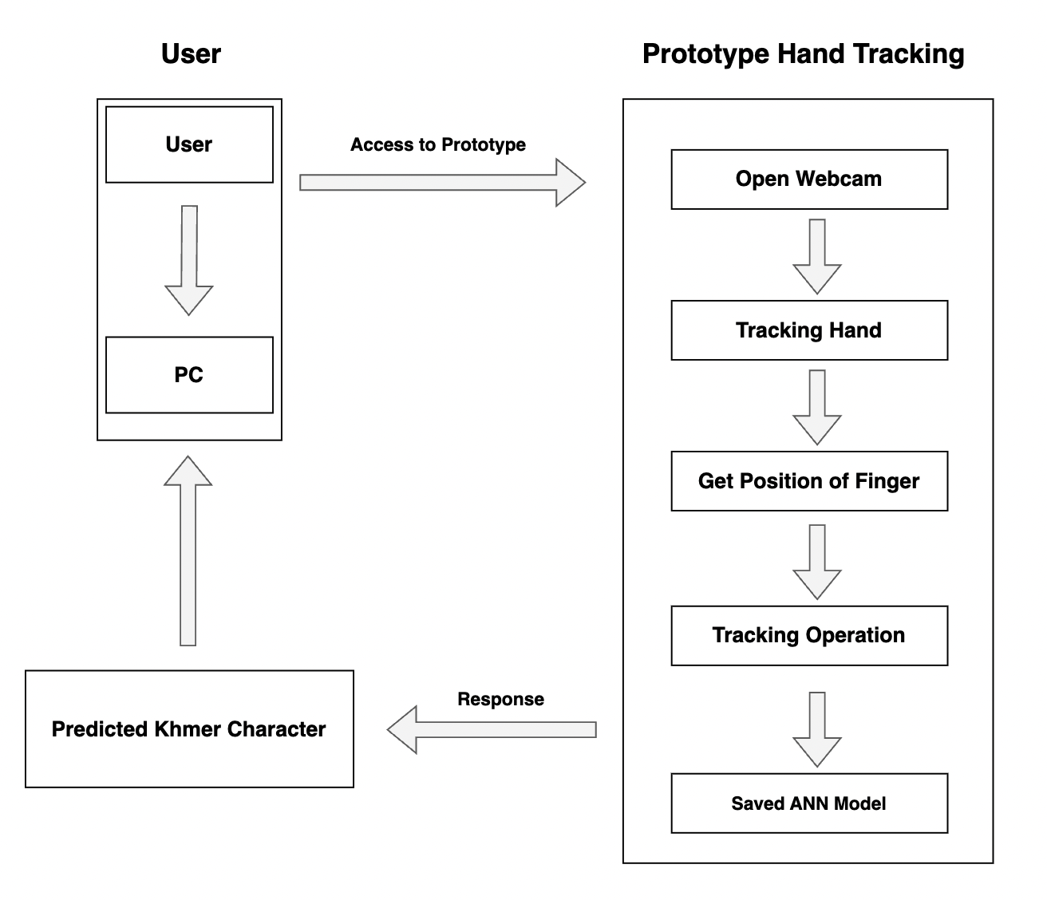
02
Introduction
Project Overview
Analysis and Design
Implementaion
Conclusion
Demo
Prototype Development
Work Flow
Access to Prototype
Prototype Operation
Response
6

Slide 9
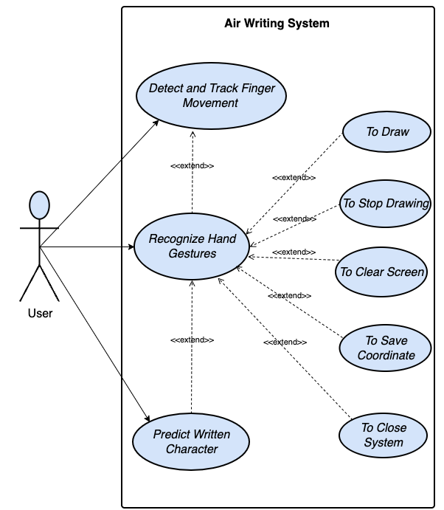
02
Introduction
Project Overview
Analysis and Design
Implementaion
Conclusion
Demo
Prototype Development (Cont.)
Use Case Diagram
Tracking Hand
Recognize Hand Gestures
Predict Written Character
7

Slide 10
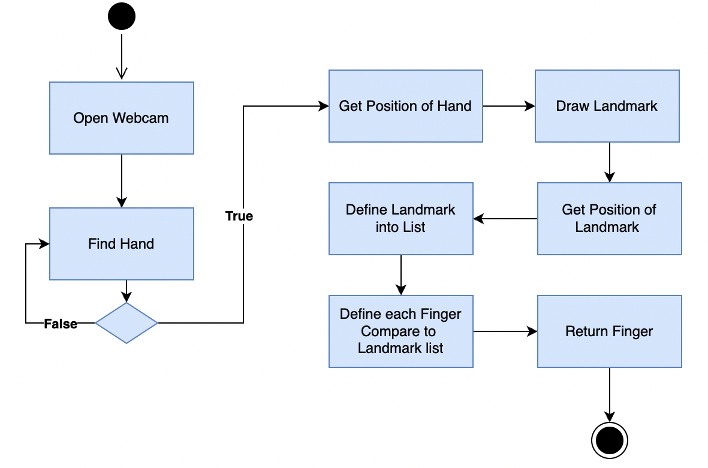
02
Introduction
Project Overview
Analysis and Design
Implementaion
Conclusion
Demo
Prototype Development (Cont.)
Hand Tracking Activity Diagram
Open Webcam
Detect Hand
Getting Hand Information
Drawing Landmark
8

Slide 11
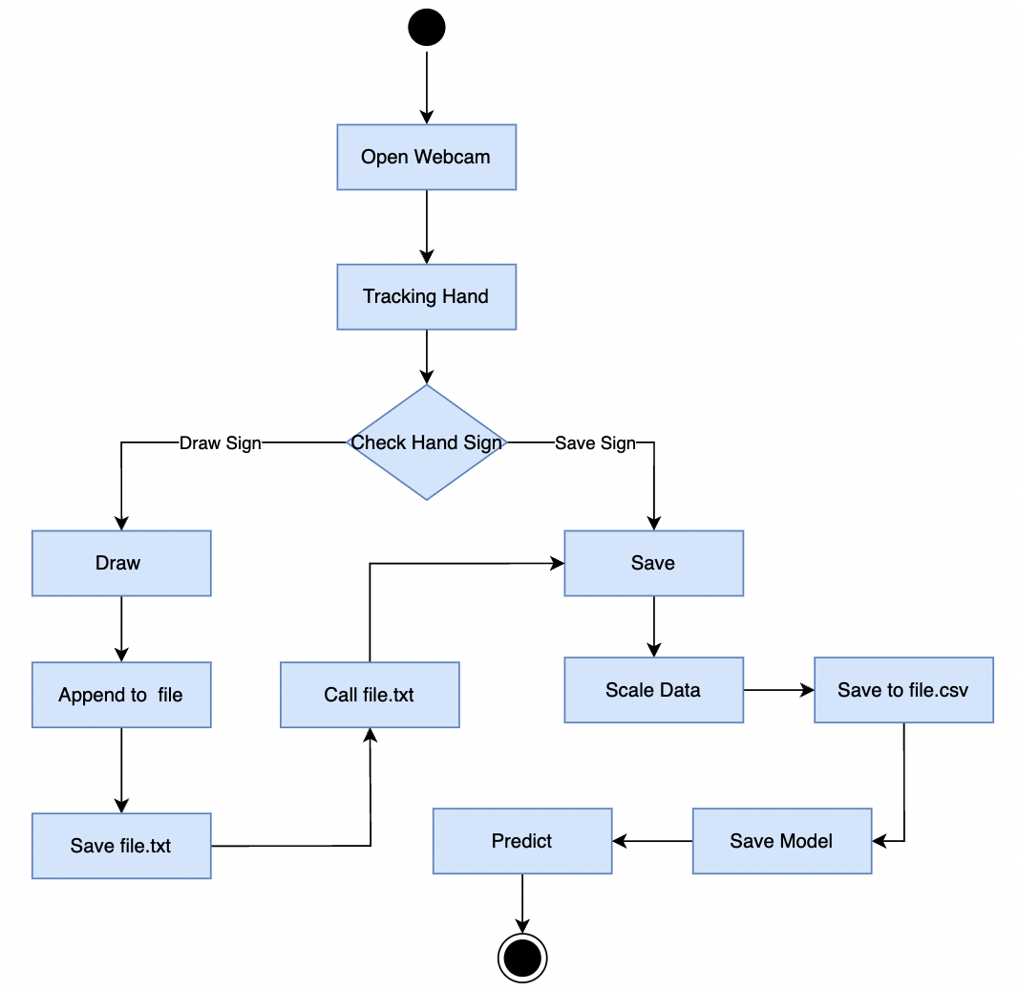
02
Introduction
Project Overview
Analysis and Design
Implementaion
Conclusion
Demo
Prototype Development (Cont.)
Drawing and Prediction Activity Diagram
Open Webcam
Tracking Hand
Check Hand Sign
9

Slide 12
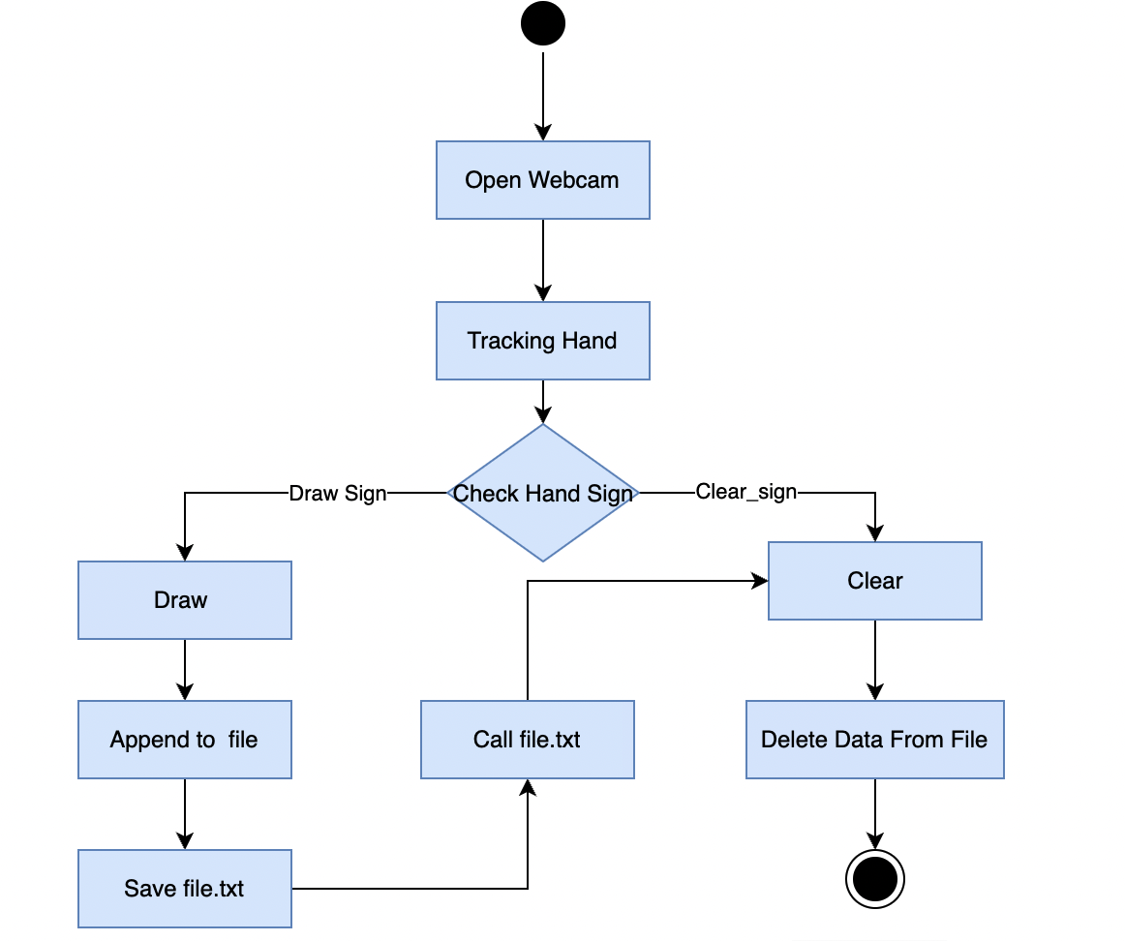
02
Introduction
Project Overview
Analysis and Design
Implementaion
Conclusion
Demo
Prototype Development (Cont.)
Drawing and Clear Activity Diagram
10

Slide 13




03
Introduction
Project Overview
Analysis and Design
Implementaion
Conclusion
Demo
Choices and Related Technologies
Technologies
Artificial Neural Network
Computer Vision
Pge and Framework
Python
Pytorch
OpenCV
11

Slide 14





03
Introduction
Project Overview
Analysis and Design
Implementaion
Conclusion
Demo
Choice and Related Technologies (Cont.)
Library
Mediapipe
Numpy
Pandas
Tool
Visual Studio Code
Anaconda
12

Slide 15
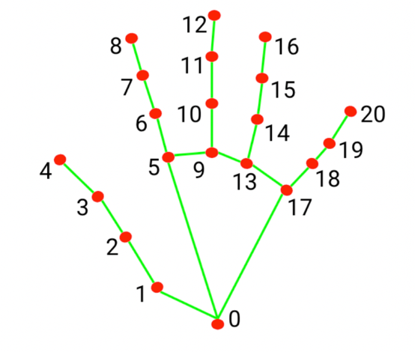
01
Introduction
Project Overview
Analysis and Design
Implementaion
Conclusion
Demo
Prototype Implementation
Initialization of the Hand Tracker
Find Hand
Draw Landmark
Determine Fingers
13

Slide 16
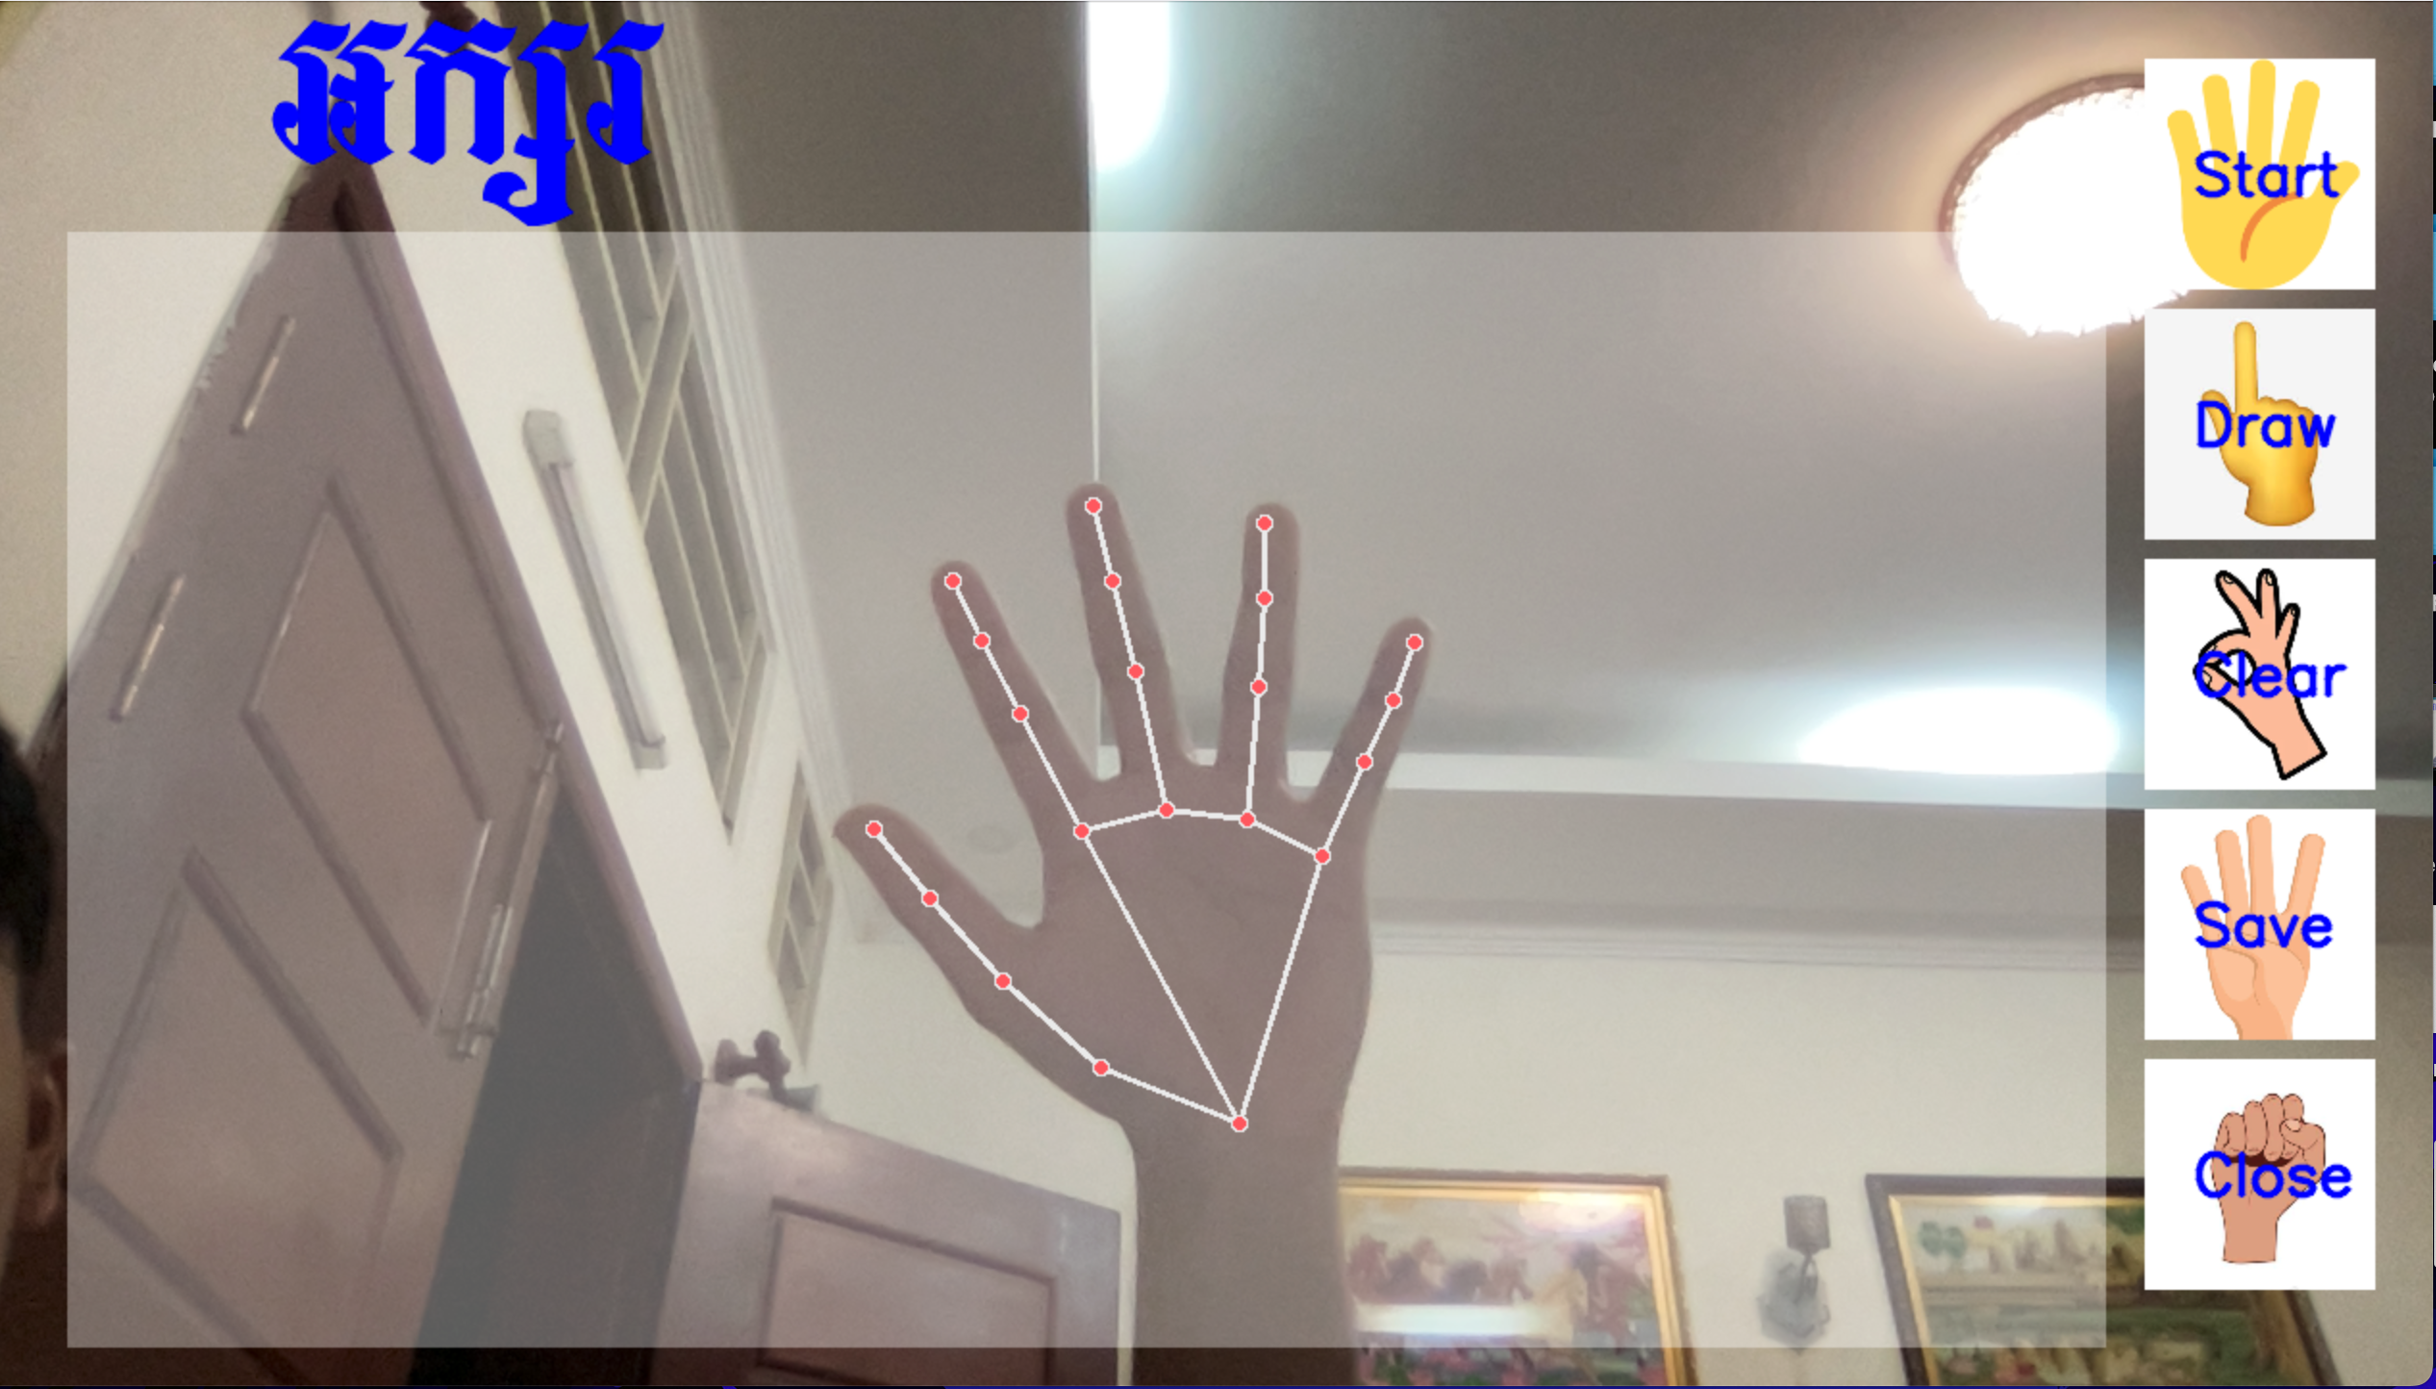
01
Introduction
Project Overview
Analysis and Design
Implementaion
Conclusion
Demo
Prototype Implementation (Cont.)
Capturing Video Frame
Text
Image
Draw Bounding Box
Display Text and Image on Frame
Call Hand Tracker
Bounding Box
Hand Tracker
14

Slide 17
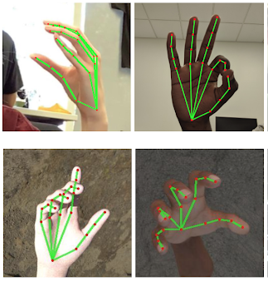
01
Introduction
Project Overview
Analysis and Design
Implementaion
Conclusion
Demo
Prototype Implementation (Cont.)
Recognizing Finger Gestures
Drawing
Stop Drawing
Save and Predict
Clear
Close prototype
15

Slide 18
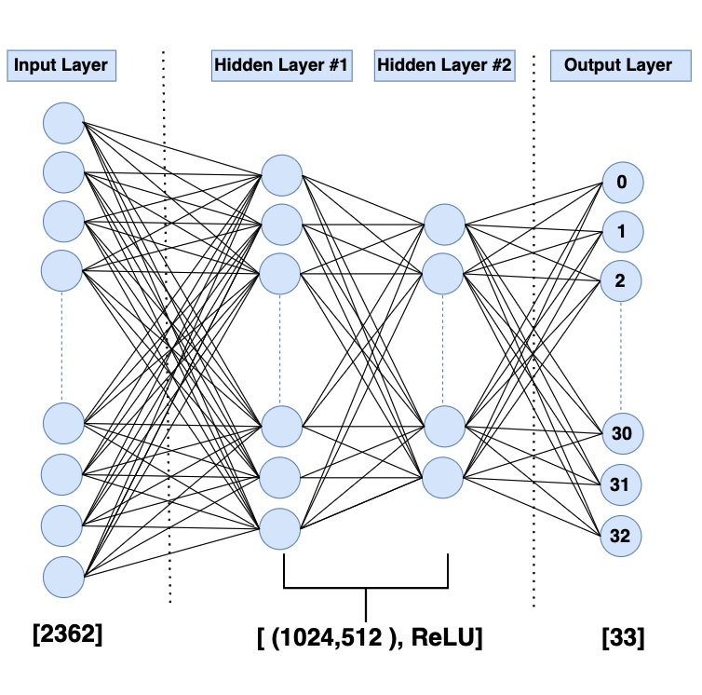
02
Introduction
Project Overview
Analysis and Design
Implementaion
Conclusion
Demo
Artificial Neural Network Architecture
Architecture:
We use simple feedforward neural network, Artificial Neural Network (ANN).
Input Layer
Hidden Layers
Output Layer
16

Slide 19

03
Introduction
Project Overview
Analysis and Design
Implementaion
Conclusion
Demo
ANN Model and Prototype Integration
How does an ANN model work with a prototype?
Training Model
Save Model
Load Saved Model in Prototype
6
17

Slide 20
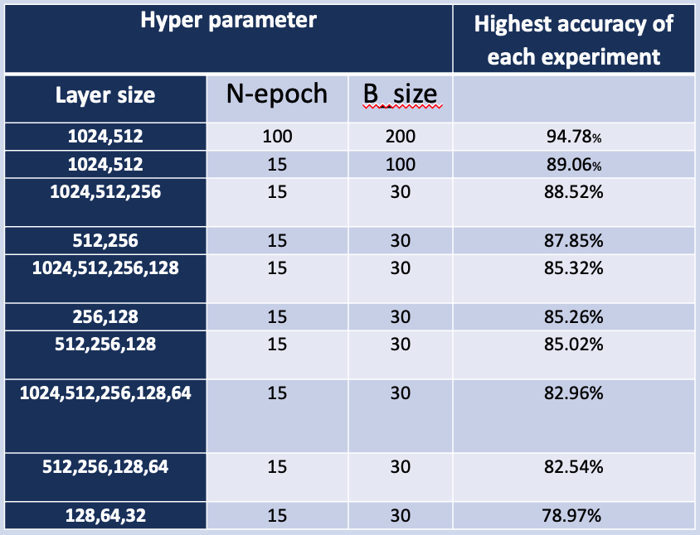
01
Introduction
Project Overview
Analysis and Design
Implementaion
Conclusion
Demo
Conclusion
Results
Get acceptable Layers Size
High Accuracy
Working Well
18

Slide 21
01
Introduction
Project Overview
Analysis and Design
Implementaion
Conclusion
Demo
Conclusion (Cont.)
Experience:
Time and Process Management
Soft skills, working with the teammates
Learning new technologies related to AI
Acquire new technical skills in coding and research
Perspectives:
Construct larger datasets to improve the performance of the recognition model
Extend to word and short phrase recognition
Integrate Khmer Air Writing to other applications or systems
19

Slide 22

Introduction
Project Overview
Analysis and Design
Implementaion
Conclusion
Demo
Click Here To See the Demo
20

Slide 23

Thank for your attention !
21

